Slide 1
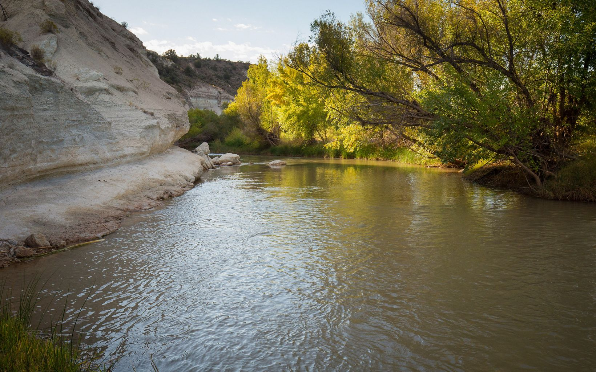
The Verde River

Slide 2
About the Verde
The 192-mile river begins as springs near Paulden
40 miles designated National Wild and Scenic River
Riparian oasis surrounded by arid land
Supports 50+ threatened or endangered species
Critical flyway for migratory birds
Free-flowing except for 2 dams around mile 137
Supplies ~40% of the surface water SRP delivers annually to Phoenix for municipal and agricultural use
Notes:
In a southwestern state where perennial flowing water is rare, the riparian oasis of the Verde River stands in stark contrast to the arid uplands through which it meanders.
The river's high-quality habitat supports the more than 50 threatened, endangered, sensitive, or special status fish and wildlife species.
The river corridor contains archaeological evidence of occupation and agricultural use and modification of the Verde River floodplain, terraces and hill slopes by people related to the Hohokam and Southern Sinagua cultural traditions over a period of at least 600 years.
Should water levels in Lake Mead continue to drop, the remainder of the Verde River could easily become a target for central Arizona water supply.
One of Arizona’s only federally designated Wild and Scenic Rivers
the Verde River is a critical flyway for migratory birds
Competing water rights and rapid population growth in the Prescott metropolitan area and other nearby parts of Yavapai County has caused concern that increased pumping in Big and Little Chino valleys could reduce base flow in the Verde River.
While most Southwestern rivers begin in mountainous regions with more precipitation than the lowlands below, the Verde begins in a broad alluvial basin in the Big Chino Valley.

Slide 3
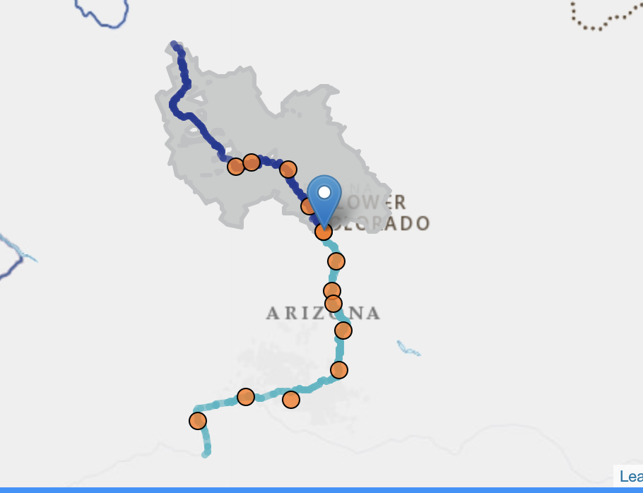
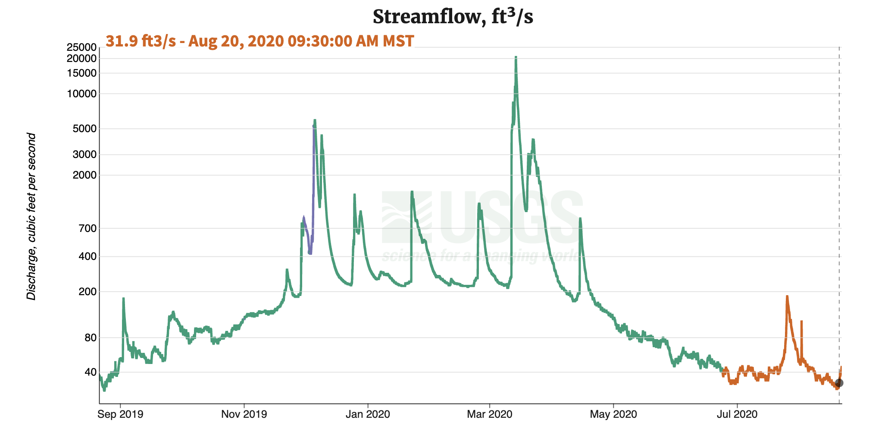
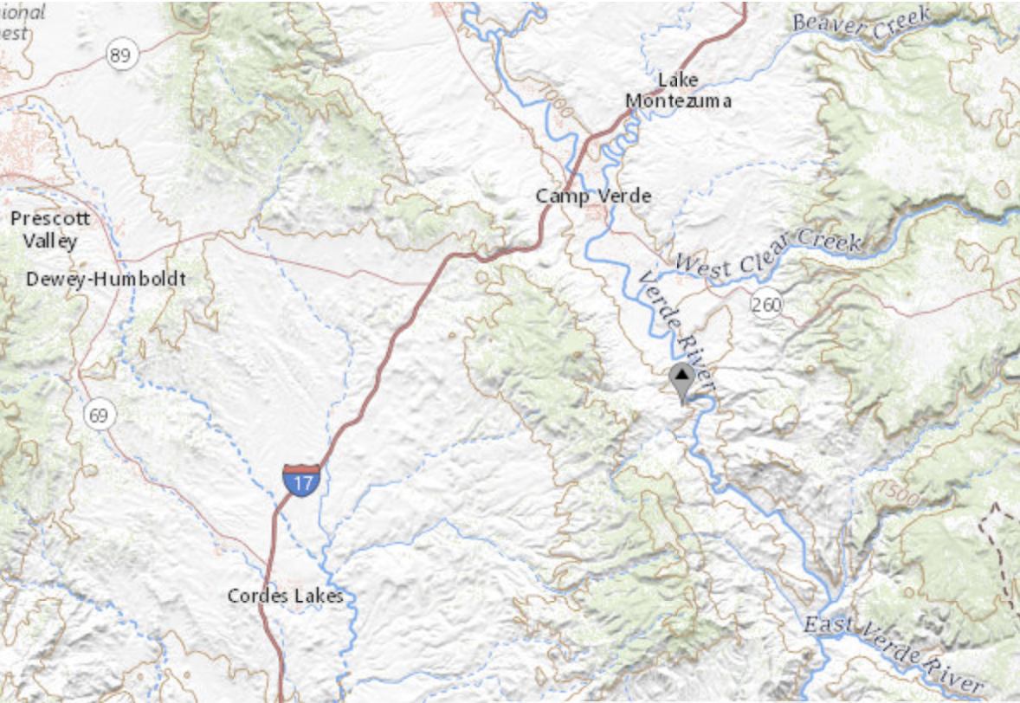

Verde River Near Camp Verde, AZ (USGS Gauge 09506000)

